Slide 1

Principal Component Analysis

Slide 2
Philosophy of PCA
Introduced by Pearson (1901) and Hotelling (1933) to describe the variation in a set of multivariate data in terms of a set of uncorrelated variables
We typically have a data matrix of n observations on p correlated variables x₁,x₂,…x_{p}
PCA looks for a transformation of the x_{i} into p new variables y_{i} that are uncorrelated

Slide 3
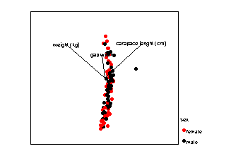
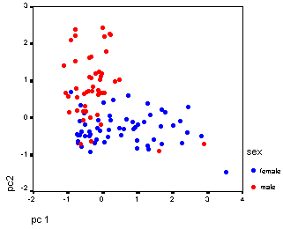
The data matrix
case | ht (x₁) | wt(x₂) | age(x₃) | sbp(x₄) | heart rate (x₅)
1 | 175 | 1225 | 25 | 117 | 56
2 | 156 | 1050 | 31 | 122 | 63
n | 202 | 1350 | 58 | 154 | 67

Slide 4
Reduce dimension
The simplet way is to keep one variable and discard all others: not reasonable!
Weight all variable equally: not reasonable (unless they have same variance)
Weighted average based on some citerion.
Which criterion?

Slide 5
Let us write it first
Looking for a transformation of the data matrix X (nxp) such that
Y= δ^{T} X=δ₁ X₁+ δ₂ X₂+..+ δ_{p} X_{p}
Where δ=(δ₁ , δ₂ ,.., δ_{p})^{T} is a column vector of weights with
δ₁²+ δ₂²+..+ δ_{p}² =1

Slide 6
One good criterion
Maximize the variance of the projection of the observations on the Y variables
Find δ so that
Var(δ^{T} X)= δ^{T} Var(X) δ is maximal
The matrix C=Var(X) is the covariance matrix of the X_{i} variables

Slide 7
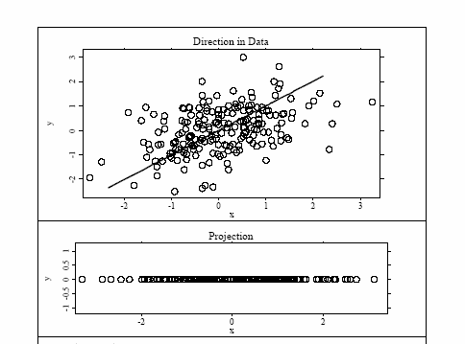
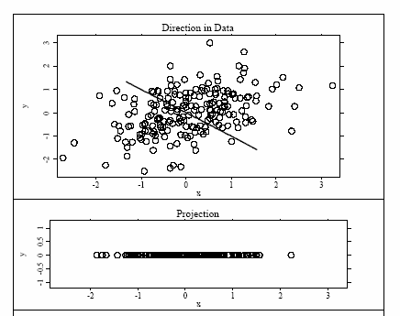
Let us see it on a figure
Good
Better

Slide 8
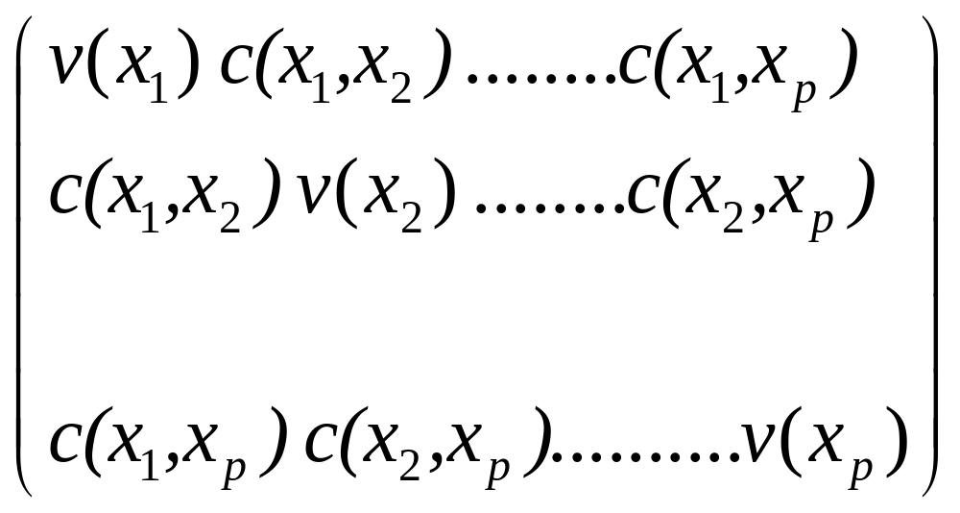
Covariance matrix
C=

Slide 9
And so.. We find that
The direction of δ is given by the eigenvector γ₁ correponding to the largest eigenvalue of matrix C
The second vector that is orthogonal (uncorrelated) to the first is the one that has the second highest variance which comes to be the eignevector corresponding to the second eigenvalue
And so on …

Slide 10
So PCA gives
New variables Y_{i} that are linear combination of the original variables (x_{i}):
Y_{i}= a_{i1}x₁+a_{i2}x₂+…a_{ip}x_{p} ; i=1..p
The new variables Y_{i} are derived in decreasing order of importance;
they are called ‘principal components’

Slide 11
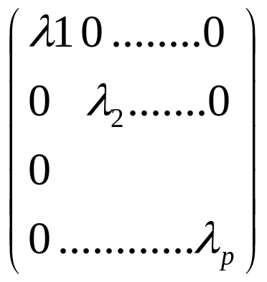
Calculating eignevalues and eigenvectors
The eigenvalues λ_{i} are found by solving the equation
det(C-λI)=0
Eigenvectors are columns of the matrix A such that
C=A D A^{T}
Where D=

Slide 12
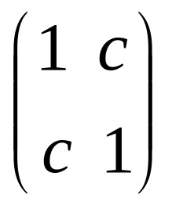
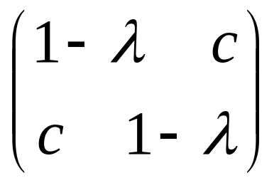
An example
Let us take two variables with covariance c>0
C= C-λI=
det(C-λI)=(1- λ)²-c²
Solving this we find λ₁ =1+c
λ₂ =1-c < λ₁

Slide 13
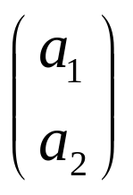
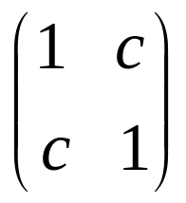
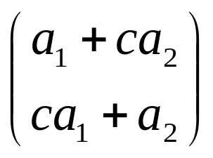
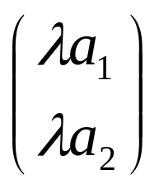


and eigenvectors
Any eigenvector A satisfies the condition
CA=λA
Solving we find
A=
CA=
=
=
A₁
A₂

Slide 14
PCA is sensitive to scale
If you multiply one variable by a scalar you get different results
(can you show it?)
This is because it uses covariance matrix (and not correlation)
PCA should be applied on data that have approximately the same scale in each variable

Slide 15
Interpretation of PCA
The new variables (PCs) have a variance equal to their corresponding eigenvalue
Var(Y_{i})= λ_{i} for all i=1…p
Small λ_{i} ⬄ small variance ⬄ data change little in the direction of component Y_{i}
The relative variance explained by each PC is given by λ_{i} /Σ λ_{i}

Slide 16
How many components to keep?
Enough PCs to have a cumulative variance explained by the PCs that is >50-70%
Kaiser criterion: keep PCs with eigenvalues >1
Scree plot: represents the ability of PCs to explain the variation in data

